Slide 1
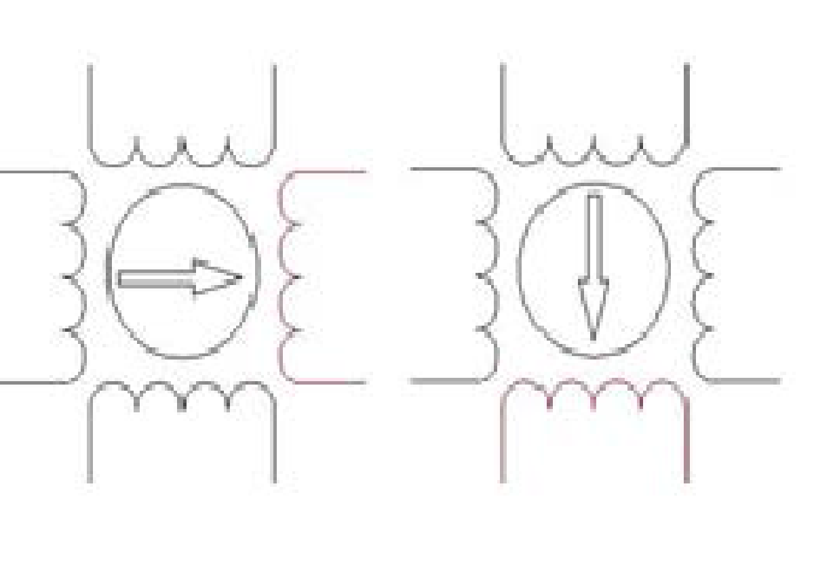
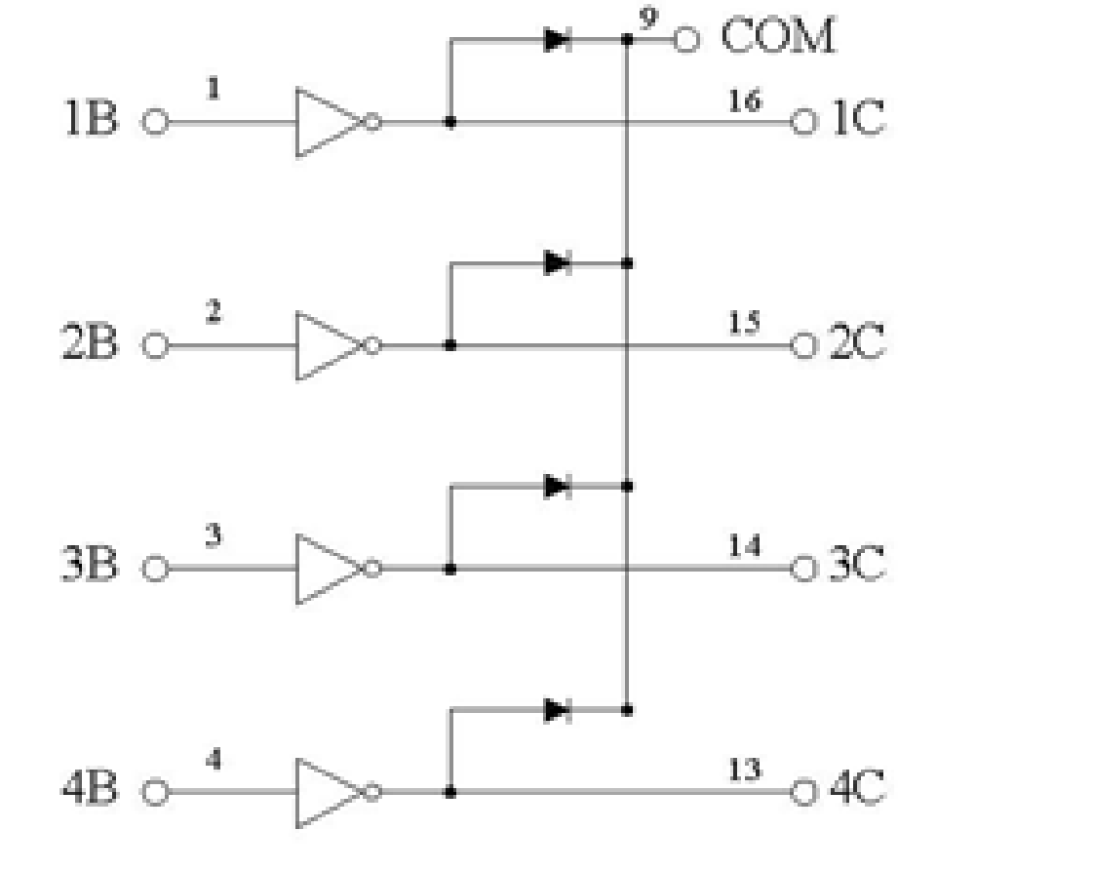
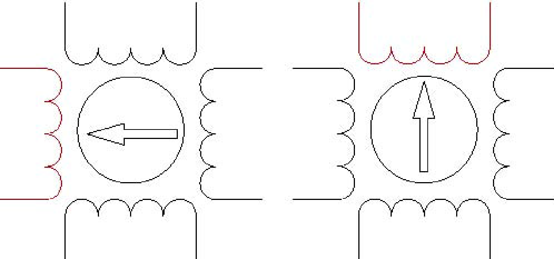

Slide 2
-- motor_ctl (4 to 7) <= (others =>'0'); -- n_steps;
-- motor_ctl (3) not used
-- motor_ctl (2) <= '0'; -- halfstep
-- motor_ctl (1) <= '1'; -- stop
-- motor_ctl (0) <= '0'; -- dir
motor_step_entity: entity motor_hw_v1_00_a.motorstep
port map ( clk => motor_clk,
rst =>not Bus2IP_Reset ,
dir => dir,
stop => stop,
halfstep => halfstep,
motor => control_motor,
step => step);
divisor_frec: entity motor_hw_v1_00_a.one_hundred_K_counter
port map ( clk => Bus2IP_Clk,
rst =>not Bus2IP_Reset ,
clk_10 =>motor_clk, -- 256 count
ce_10=> motor_ce);

Slide 3
-- implement slave model software accessible register(s)
SLAVE_REG_WRITE_PROC : process( Bus2IP_Clk ) is
begin
if Bus2IP_Clk'event and Bus2IP_Clk = '1' then
if Bus2IP_Reset = '1' then
motor_ctl(0 to 7) <= motor_inic;
motor_ctl (8 to 31) <= (others => '0');
elsif (slv_reg_write_sel="10") then
for byte_index in 0 to (C_SLV_DWIDTH/8)-1 loop
if ( Bus2IP_BE(byte_index) = '1' ) then
motor_ctl(byte_index*8 to byte_index*8+7) <= Bus2IP_Data(byte_index*8 to byte_index*8+7);
end if;
end loop;
else
if (internal_stop='0') then
if (motor_ce='1') then
if (motor_ctl(4 to 7)=("0000")) then
motor_ctl(1) <= '1'; -- se detiene el motor
else
motor_ctl(4 to 7) <= motor_ctl(4 to 7) - 1; -- decrementa n_steps
end if; end if; end if; end if;
end if;

Slide 4
state_machine : process (dir, stop, current_step)
begin
if (stop='0') then
if (dir='1') then
case current_step is
when s1 => next_step <= s2;
when s2 => next_step <= s3;
when s3 => next_step <= s4;
when s4 => next_step <= s5;
when s5 => next_step <= s6;
when s6 => next_step <= s7;
when s7 => next_step <= s8;
when s8 => next_step <= s1;
end case;
else
case current_step is
when s1 => next_step <= s8;
when s8 => next_step <= s7;
when s7 => next_step <= s6;
when s6 => next_step <= s5;
when s5 => next_step <= s4;
when s4 => next_step <= s3;
when s3 => next_step <= s2;
when s2 => next_step <= s1;
end case;
end if;
else -- stop='1'
next_step <= current_step;
end if;
end process;

Slide 5
with (current_step) select
-- motor unipolar
motor <= "1000" when s1,
'1' & halfstep & "00" when s2,
"0100" when s3,
"01" & halfstep & '0' when s4,
"0010" when s5,
"001" & halfstep when s6,
"0001" when s7,
halfstep & "001" when s8,
"0000" when others;
with current_step select
step <=
"000" when s1, --0
"001" when s2, --1
"010" when s3, --2
"011" when s4, --3
"100" when s5, --4
"101" when s6, --5
"110" when s7, --6
"111" when s8, --7
"111" when others; --7

Slide 6
La función para hacer girar al motor, que viene definida en el directorio driver correspondiente al periférico,
MOTOR_HW_mWriteSlaveReg0 (MOTOR_HW_BASEaddress, 0, Data)
donde Data debe almacenar la información de control según se ha especificado en el apartado anterior:
• La dirección de giro se encuentra en slv_reg0(0);
• La señal de stop se encuentra en slv_reg0 (1);
• La señal de halfstep se encuentra en slv_reg0 (2);
• El número de pasos a girar está en slv_reg0 (4 to 7).
Así, para que el motor comience a girar (stop=0) en sentido horario (dir=1), pasos completos (halfstep=0), y avance 15 pasos (nnnn=15), debemos hacer:
Data =0 x9E000000 ;
MOTOR_HW_mWriteReg ( MOTOR_HW, BASEaddress , 0, Data );

